Slide 1
Course Overview
Introduction to Game Design and Development
ITCS 4230/5230
Dr. Dewan Tanvir Ahmed
Department of Computer Science
University of North Carolina at Charlotte

Slide 2
Course Expectations Understanding Fun!

Slide 3
You have to want to do this, if you are to succeed.
Video game programming is one of the hardest computer science disciplines. Don’t believe me? Just wait and see.
"It's time to kick ass and chew bubble gum...and I'm all out of gum." (Duke Nukem)

Slide 4
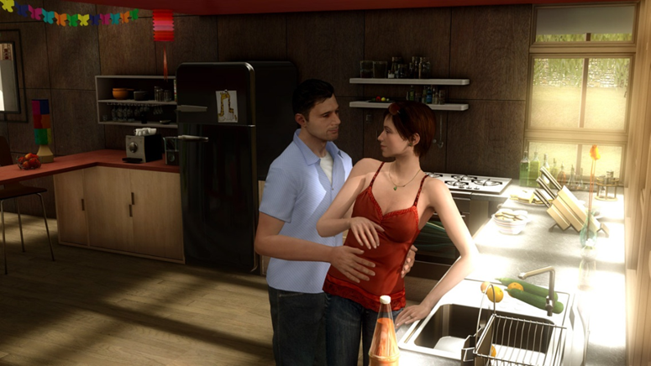
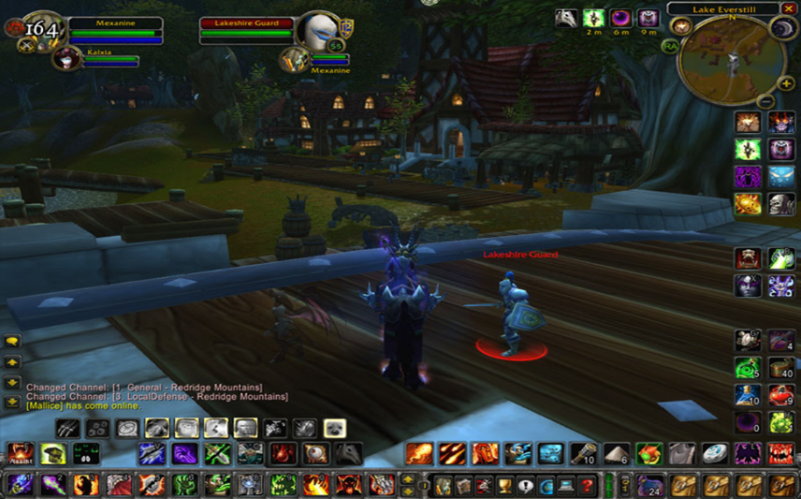
Popular Games
Heavy Rain
WoW

Slide 5
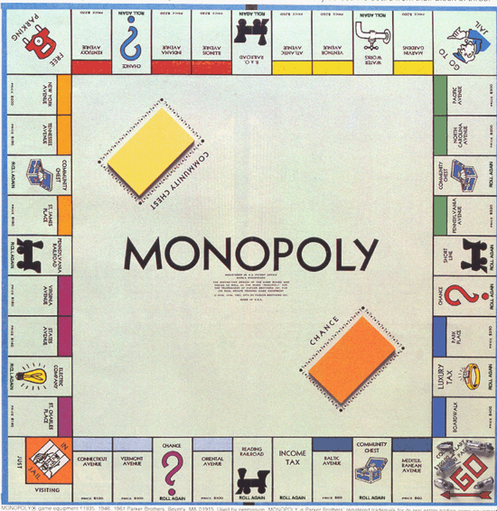



Popular Games

Slide 6
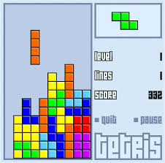
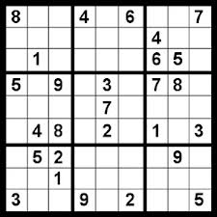
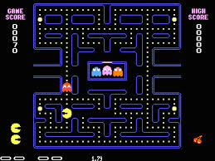
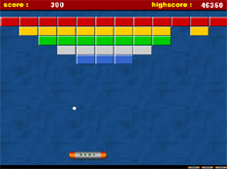
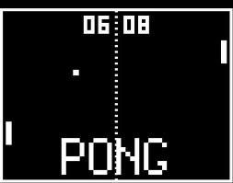
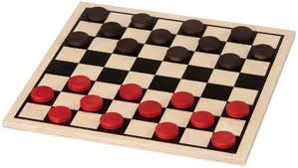
Old Games

Slide 7
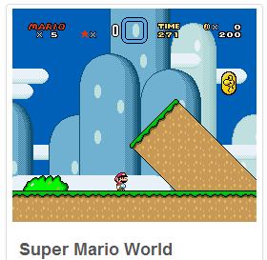

Games…

Slide 8
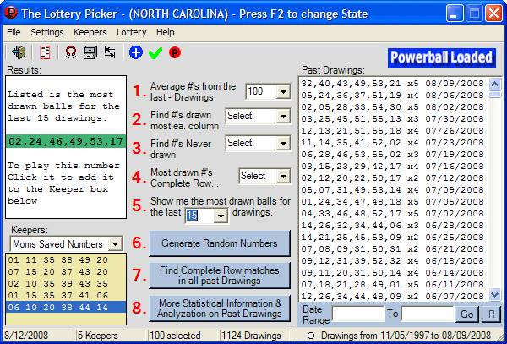
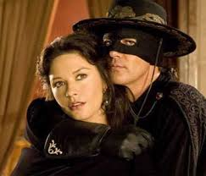
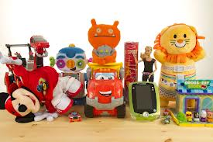


What is a Game?
What are the differences for the followings?
Software
Movie
Toys
Novel
Game

Slide 9
What is a Game?
Movie?
No interaction, outcome fixed
Toy? (has interaction - why not?)
No rules or goal, but still fun
Players can develop own goals
Puzzle? (has goal + interaction - why not?)
Strategy and outcome is the same each time
Notes:
Toys and puzzles can be used to play games.

Slide 10
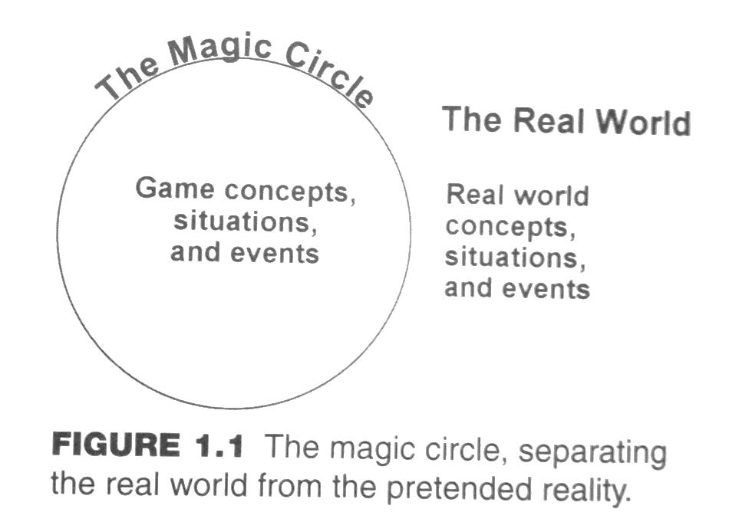
Definition of Game
Definition - A game is a type of activity, conducted in the context of a pretended reality, in which the participants try to achieve at least one arbitrary, nontrivial goal by acting in accordance with rules.
A game must include
Play activity
Pretended reality
A nontrivial goal
Rules

Slide 11
Essential Elements of a Game
Play
Participatory
Non-linear
Fun
Pretending
Artificial
importance
(magic circle)
Goals
Will result in:
Facing challenges
Performing actions
Rules
Define goals, challenges, & actions.
Understandable!
Notes:
Play:
Participatory form of entertainment whereas books, films, and theater are presentational forms.
Non-linear – each time you play a game, you can make different choices and have a different experience.
Play ultimately includes freedom to act and the freedom to choose how you act.
The freedom is not unlimited. Your choices are constrained by rules, and this requires you to be clever, imaginative, or skillful in your play.
Fun
Goal:
Must have one or more goals.
As you know: goalless play is not the same as game play.
Even creative and noncompetitive play has a goal: creation.
The output may be not quantifiable. (collaborative drawing)
The object of SimCity is it build and manage a city without going bankrupt, and as long as one does not go bankrupt the game continues indefinitely without any outcome.
The goal must be nontrivial because a game must include some element of challenge.
Rules of victory condition, termination condition, loss condition.

Slide 12
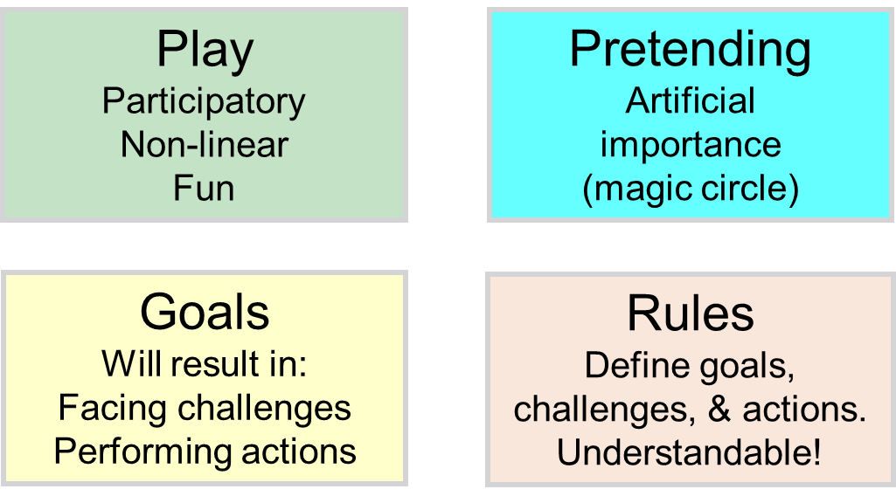
Essential Elements of a Game (Cont.)
Play requires participation.
Making different choices while playing the game a second time affects the results
Creates an artificial reality known as the magic circle
Artificial importance is assigned to events within the magic circle
To leave the magic circle, stop playing the game
Notes:
Actions that can be made while playing are limited by the rules.

Slide 13
Essential Elements of a Game (Cont.)
Rules are definitions and instructions that players accept for the game
Rules define the actions the players may select that will help them achieve the object of the game
Game designers must make the rules understandable to the player

Slide 14
Essential Elements of a Game (Cont.)
Must have a nontrivial goal or objective
The rules define the goal
The game designer sets the rules, thus defining the object of the game
The player must overcome one or more challenges to achieve the goal
The goal is often a victory condition, but victory or defeat is not required in all games.

Slide 15
Things That a Game Is Not
A game does not have to include
Competition
Conflict
Entertainment
Fun
These are qualities of some games, but not essential to the definition
Serious games are not necessarily made for entertainment or fun

Slide 16
Definitions for Game (cont.)
Roger Caillois
Voluntary, uncertain, unproductive, governed by rules, make-believe
Johan Huizinga
Free activity, outside “ordinary life”
Jesper Juul
Rule-based formal system with variable quantifiable outcome, effort to influence the outcome, attachment to outcome, and optional negotiable consequences

Slide 17
Definitions for Game (cont.)
Chris Crawford
Subset of entertainment limited to conflicts with goals
Sid Meier
A series of meaningful choices
Adams and Rollings
One or more casually linked series of challenges in a simulated environment

Slide 18
Definitions for Game (cont.)
A great game is a series of interesting and meaningful choices made by the player in pursuit of a clear and compelling goal

Slide 19
A Good Game
Must have choice, or it is not interactive
Must be a series of choices or it is too simple to be a game
Must have a goal or it is a software toy
With Sim City and The Sims players may bring their own goals

Slide 20

A Good Game Uses ROSS
Rules
Outcomes
Strategy
Strategic Interdependence
Case study - Connect4 Ross Style

Slide 21
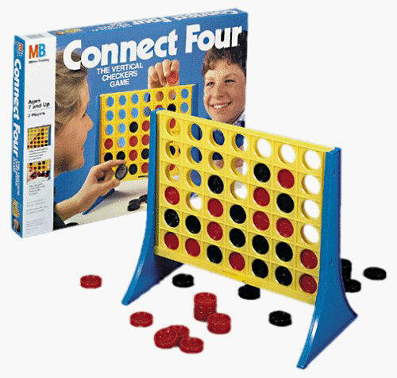
Case study - Connect4 Rules
Choose who plays first
Each player drops marker on grid
Play alternates
A row can be
Horizontal
Vertical
Diagonal
The first player to get four in a row wins
If board filled and no player has 4 in a row, tie

Slide 22
Case study - Connect4 Outcomes
Win
Tie
Loss

Slide 23
Case study - Connect4 Strategy
Aggressive –
Form lines of 3
Place pieces to form new lines
Defensive –
Block other player lines
Place pieces next to opponent’s groups

Slide 24
Case study - Connect4 Strategic Interdependence
Aggressive leads to faster wins but higher risk
Defensive leads to slower wins with less risk, can be played around
Like football, the best defense is a good offense (if you go first)

Slide 25
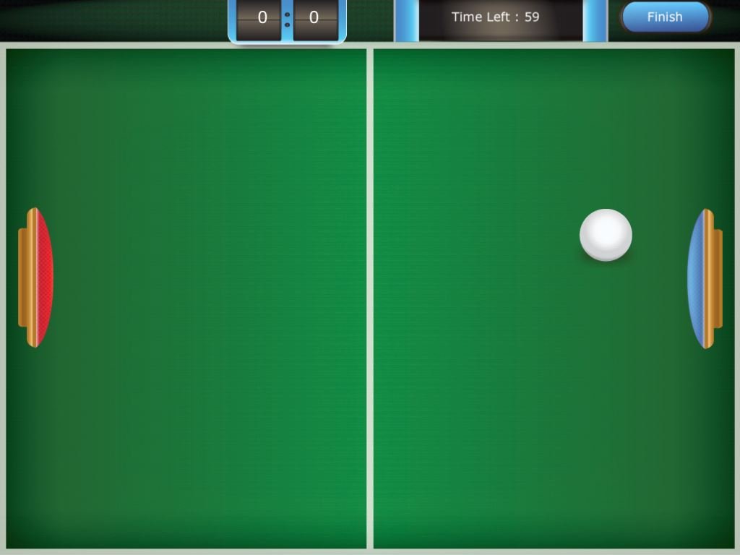
ROSS Pong

Slide 26
The term - Flow
“Flow: The Psychology of Optimal Experience” by U of Chicago professor Mihaly Csikszentmihalyi
Flow is a state of exhilaration, deep sense of enjoyment
Usually when a person’s body or mind stretched to limits to accomplish something difficult and worthwhile

Slide 27
Flow Channel

Slide 28
Difficulty Increases

Slide 29
Your Turn
Your relevant data in <= 30s
Name
Year
Degree
Why you are in this class
Your favorite game (max two)

Slide 30
Turn-In Requirements
Share with your classmates
Find matching!

Slide 31
Course Structure

Slide 32
Course Objectives
Basic concepts and techniques for game design and development
Understand the features of a good game
Get ample opportunity to design your own
Involve in a Term Project

Slide 33
References
[REQ’D] Fundamentals of Game Design. Ernest Adams, New Riders, 3rd edition.
[REQ’D] Introduction to Game Development, Steve Rabin, Cengage Learning, 2nd Edition.
[REC] Game Design Workshop: A Playcentric Approach to Creating Innovative Games, Tracy Fullerton. ISBN: 9780240809748, CRC Press.
[REC] Microsoft® XNA® Game Studio 4.0: Learn Programming Now!, 1st Edition, Rob Miles.
[REC] Game Design: Principles, Practice, and Techniques - The Ultimate Guide for the Aspiring Game Design. Jim Thompson, Barnaby Berbank-Green, Nic Cusworth. John Wiley & Sons.

Slide 34
Topics to be covered (may be in different order)
Introduction
History of video games, game genres
The games industry
Theory of funativity
Basic concepts in games
Game design teams & processes
Conceptualization
Prototyping
Digital prototype
Playtesting
Animation
Artificial Intelligence
Collision detection
XNA programming
2D board Games

Slide 35
Communication
You are expected to attend all classes.
You are accountable for all material covered, all announcements made, and all handouts given out during class.
Ways to reach me:
Come during office hours.
For appointment - send electronic mail to dahmed@uncc.edu

Slide 36
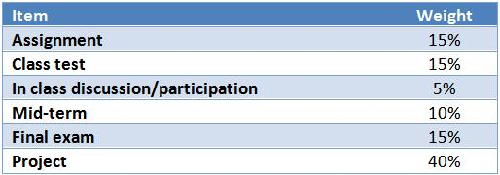
Grading and Exams
Grading will be based on the following assessment methods and along with the weights mentioned.

Slide 37
Assignments
If you miss a class you are responsible for obtaining the missed material/announcements. I may take 2 points off of your final point total for every class missed. The first two misses are free.
All assignments must be turned in by midnight of the due date. No exceptions under any circumstances.
Assignments will be submitted to Moodle. No hard copies unless mentioned.

Slide 38
Assignments (cont.)
No make-up work is available. If you miss assignments there is no way to make up the work.
All assignments are expected to be INDIVIDUAL work. All work handed in must be original.
Duplicate or very similar assignments receive zero grade. Flagrant cheating (on an exam or project, or assignment) will result in (at minimum) a FAILING GRADE for the course. Also actions will be taken according to the rules of the department, college, and university.

Slide 39
Assignments (cont.)
Some projects will be the exceptions to the above rule. These will be completed in teams.
SAVE your intermediate work until an assignment has been graded and recorded. KEEP backup copies of the final versions of your assignments and projects.
Periodically, TAs will post grades as they have them recorded. It is your responsibility to check these listings to ensure their correctness.

Slide 40
Assignments (cont.)
Handwritten assignments should be neat and easy to read (Or else type them!). Include your name and section number on every page and in every stack. Your term project design statements must be typed.
It is more productive to use the computer for entering, editing, and running scripts, and then spend time AWAY from the machine debugging a script.
Don't get behind in this class! Start each assignment as soon as it is handed out, so that you have time to ask questions and can use your time wisely.

Slide 41
Tasks
Assignment
Upload a photo to your Moodle account profile
Play games of your interest!

Slide 42
Finally…
Start thinking of a game idea and your team!!

Slide 43


